Slide 1
Fluorescence Quantification With Multiple ROIs per Cell
Krista Pipho BCH 571
Fall 2018
Why is it important?
We want to analyze fluorescence intensity differences between cells in different samples. We can only get high magnification images of so many cells in one confocal microscopy section.

Slide 2
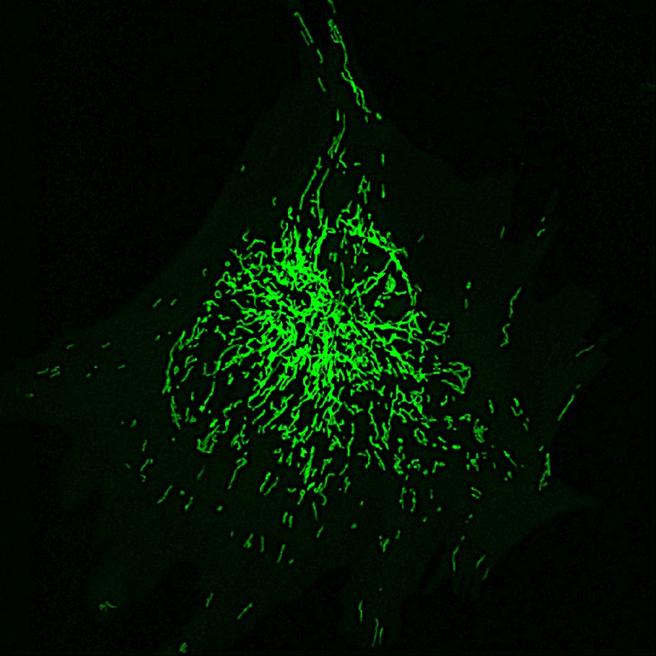
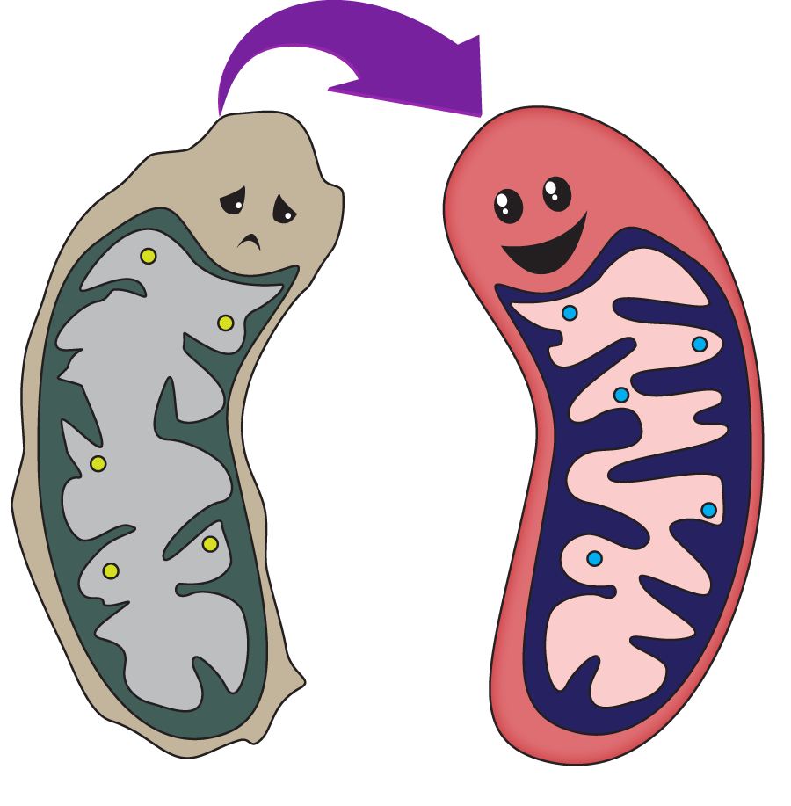
We want to quantify differences in fluorescence intensity between cells in different samples
What is the problem?
Mitochondrially localized fluorophore

Slide 3
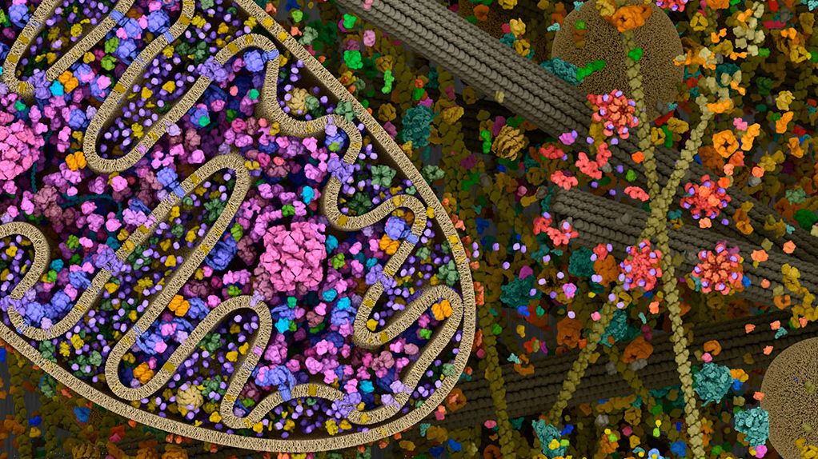
Our fluorescent probe is mitochondrially localized. Mitochondria are not uniformly distributed within a cell.
In order to make the most of our limited sampling of cells, we wish to take many separate measurements of the mitochondrial network within each cell.

Slide 4
We Want:
We Have:
TIFF images
Multiple cells per image
Overlay with cell outlines
Multiple channels per image
20 ROIs per cell
Readings from all channels
-Area
-Mean Gray Value
-Integrated Pixel Intensity

Slide 5
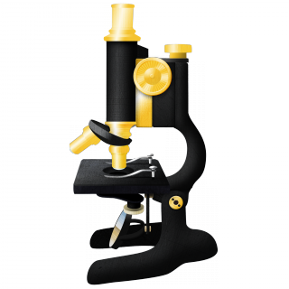
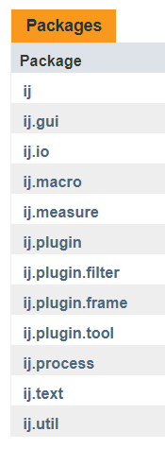
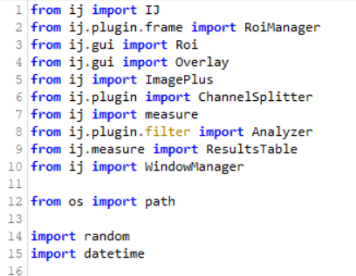

Image J, FIJI, and the ij API

Slide 6
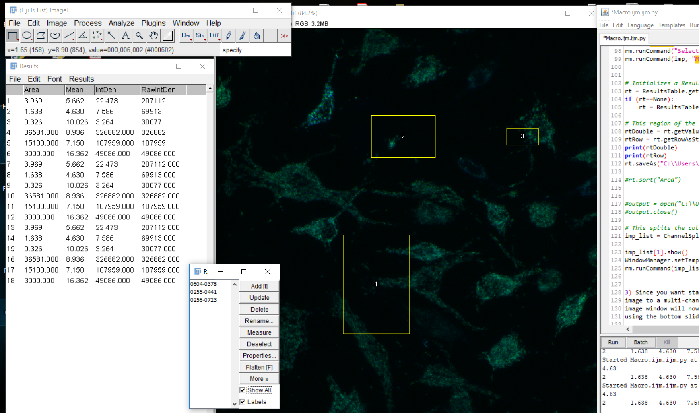

Slide 7
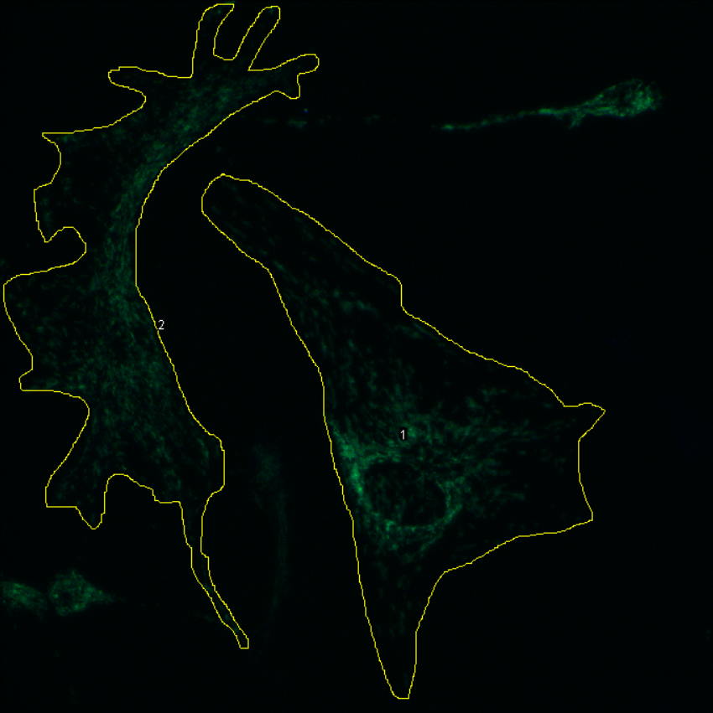
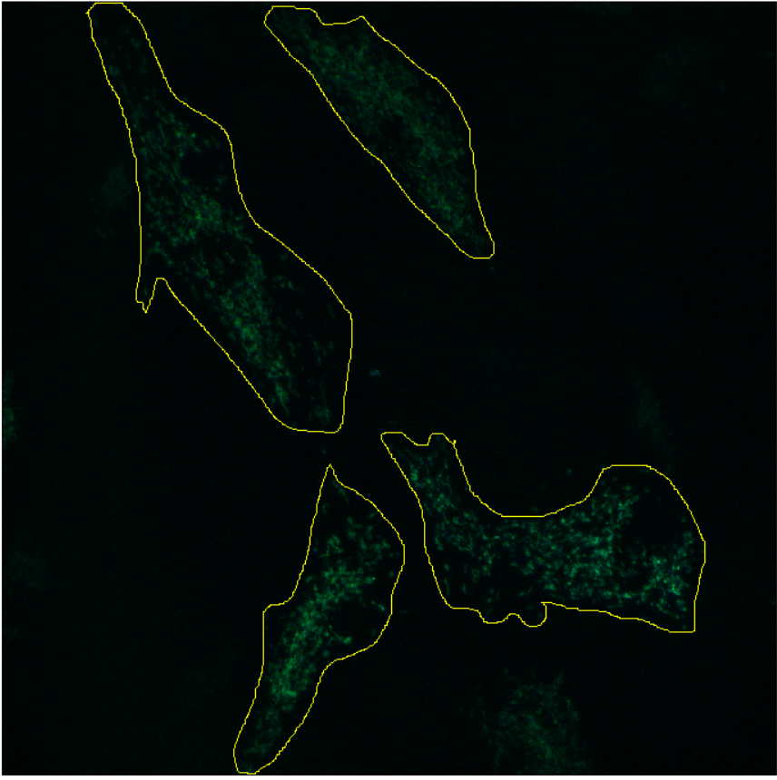
Example Input

Slide 8
Use Batch Processor
Turn outlines into ROIs
#ROI = #Cells
For each cell, find bounding box
Randomly generate ROIs inside

Slide 9
Before accepting the new ROI:
Check if it is entirely contained within the cell
VS
Check if it overlaps previously accepted ROIs
VS

Slide 10
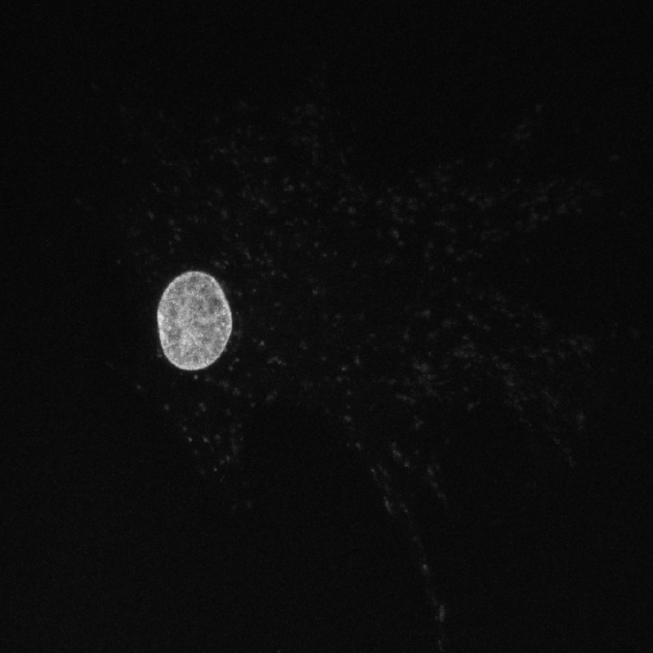
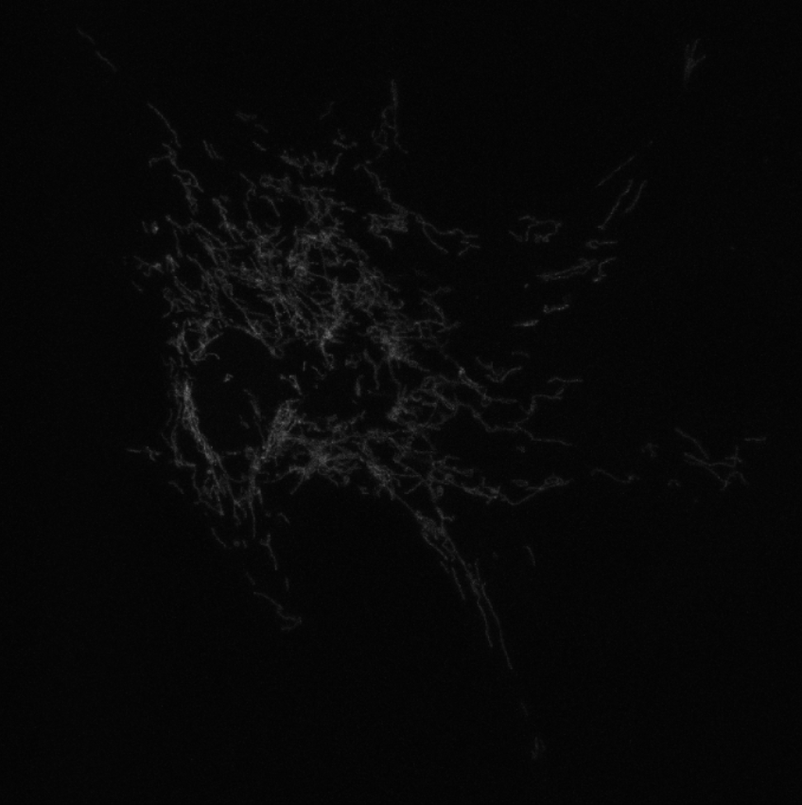
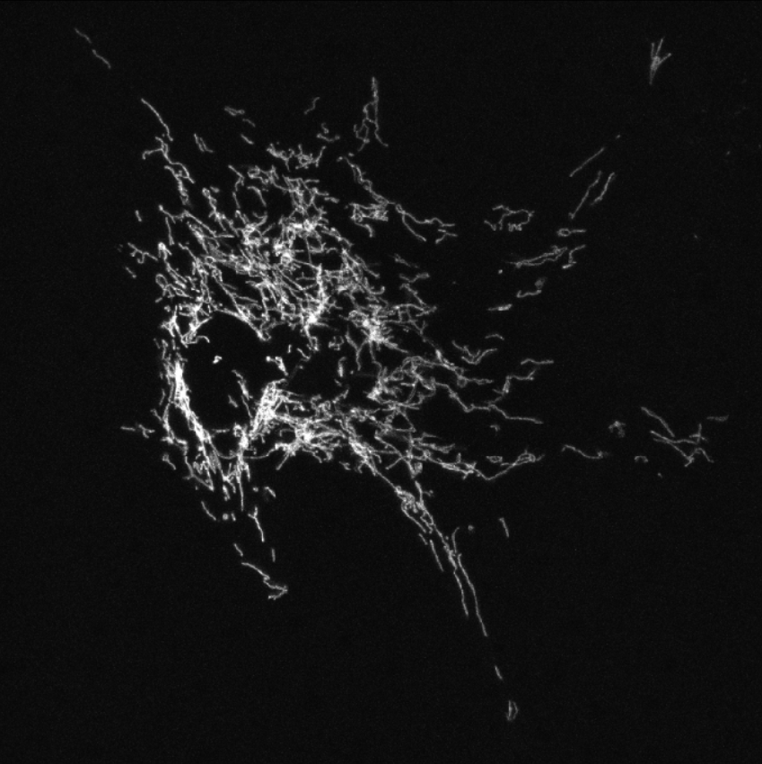
Channel Splitting

Slide 11
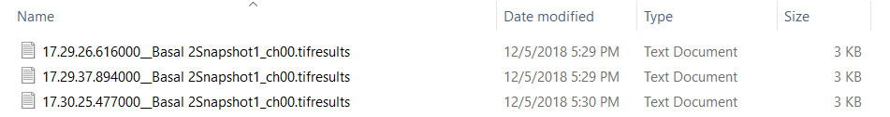
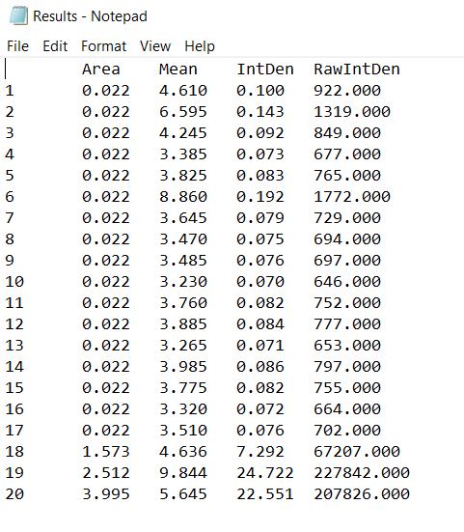
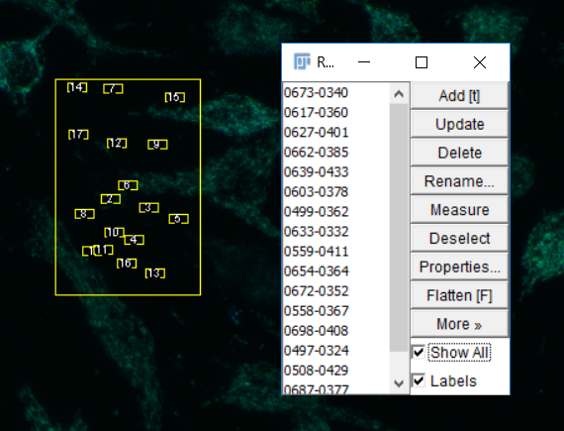
Results

Slide 12
Image Credits
https://www.sens.org/research/intramural/mitochondrial-mutations/mitochondrial-repair-project
https://www.dreamstime.com/stock-image-tangled-wires-image27063551
https://hipwallpaper.com/mitochondria-wallpapers/

Slide 13
ROI Page
Take the cell outline (in the ROI manager)
Get the bounding box values
Generate random x/y pixel coordinates within the bounding box corrected for the size of the rectangle
Then add the first ROI and the second ROI together into a shape ROI and ask for the area
See if the area is evenly divisible by the area of each individual rectangle
That will check to see that the rectangles don’t overlap eachother
Then add the cell outline to the shape ROI and measure if the area of the resulting shape ROI = the area of the original shape ROI
If so, then neither of the new ROIs hang out past the boundaries of the cell
If either of these conditions are violated, remove the most recently generated ROI and try again
If no true solutions are found within 20 iterations of this process, return the ROIS that you have
Otherwise, proceed until the specified number of ROIs you set are placed

Slide 14
What strategies were used to solve the problem?
I was doing image analysis in ImageJ and you can write macros to automate the process
Wrote a macro in Jython that uses the imageJ api to systematically call on imagej functionality
Then show tour of the background
Little bit of a flowchart
Use the batch processor to sequentially open images
Turn all of the cell outlines and background spots into ROIs
For each of the ones that are a cell, generate 20 randomly placed sub-rois
Then split the channels of the image to measure fluorescence intensity at _____ wavelength and ______ wavelength separately
Find measurements for all the ROIS
Grab the results from the results table, format them, and save them as a txt file
Then visualize the resulting data using R

Slide 15
Provide enough detail so that the approach could be reproduced

Slide 16
What is the input and output for the program?
The input are confocal fluorescent microscopy .tif files of cells with saved overlays outlining each cell.
The output is a txt file with measurements of area integrated pixel intensity mean grey value for the background spots, the cells, and each of the rois drawn inside the cells.

